Slide 1
Serialization and deserialization
Serialization:
Serialization is a process of converting an object into a stream of bytes,xml file, or soap message or Json Object.
Serialization required when transferring or storage data from client to server over network
bytes
Object
Serialization
Xml file
Soap message
JSON

Slide 2
Serialization and deserialization
Deserialization:
Deserialization is a process of Reconstruct the object from stream of bytes or xml file or soap message or Json.
To perform serialization and deserialization they are 4 types of standards.
1.Binary serialization.
2.Xml serialization.
3.Soap serialization
4.Json serialization
To work with Serialization .NET comes with a predefined library
System.Runtime.Serialization
Advantage of serialization is transportation of an object through a network

Slide 3
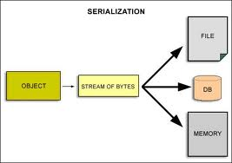
Serialization and deserialization

Slide 4
Binary Serialization
Binary serialization:
In Binary serialization the object is converted into Binary stream.
Binary serialization used to transport data across the network.
Binary serialization is known for its light and fast and compact nature
Remoting uses the Binary Serialization.
To work with this standard serialization .NET provide a name space
System.Runtime.Serialization.Formattors.Binary
Metods of BinaryFormatter class
void Serialize(Stream serializationStream, object graph) Convert the object into stream
object Deserialize(Stream serializationStream) Re construct the object from stream.

Slide 5
Serialization and deserialization
Serializable attribute: it is an attribute which should mention immediately above the class declaration whose object you want to serialize or deseralize.
[Serializable]
class emp
{
}

Slide 6
Serialization and deserialization
Soap serialization: In Soap serialization objects convert into SOAP messages
To work with this standard .NET provide a name space
System.Runtime.Serialization.Formatters.Soap
SoapFormater class Metods:
void Serialize(Stream serializationStream, object graph);
Object Deserialize(Stream serializationStream)
Advantage of using the SOAP or Binary serialization is that you can serialize the entire object

Slide 7
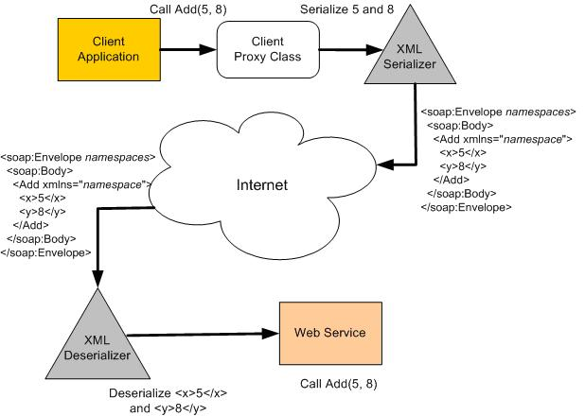
Serialization and deserialization

Slide 8
Serialization and deserialization
xml standard: this is used for maintaining and restoring the object in a xml format
By using XML serialization only public properties and fields can be serialized.
XML serialization does not convert methods, indexers, private fields, or read-only properties.
XML Serialization is much slower compared to Binary serialization.
To work with this standard .NET provide a name space
System.Xml.Serialization
Methods of XmlSerializer :
void Serialize(Stream stream, object o);
Object Deserialize(Stream stream);

